Slide 1
CUSTOMER CHURN PREDICTION IN TELCO COMPANy USING MACHINE LEARNING ALGORITHM
Muhammad Naufal Luthfi
Jakarta
2021

Slide 2
Project Description
Churn is a condition where a customer stops using a product or service. A telco company has a problem because many of its customers are churning out. Therefore, the company wanted to find a way to solve this problem using machine learning algorithms.

Slide 3




GOAL
Data Cleaning
Data Visualization
Create web application
Modelling
Testing
Create a machine learning model that can predict at least 80 percent of customers who will churn and create a web application from a local host based on the model that has been selected to predict whether a customer will churn or not

Slide 4
Dataset
Dataset for this project comes from kaggle taken from the IBM Sample Dataset. Each row in the dataset represents each customer and each column in the dataset contains specific information from each customer.
Source : Kaggle.com
Total Data : 7043 rows × 21 columns
Target Column : Churn
Column : (customerID, gender, SeniorCitizen, Partner, Dependents, tenure, PhoneService, MultipleLines, InternetService, OnlineSecurity, OnlineBackup, DeviceProtection, TechSupport, StreamingTV, StreamingMovies, Contract, PaperlessBilling, PaymentMethod, MonthlyCharges, TotalCharges)

Slide 5
Data Cleaning
Change target column (Churn) into numerical
Delete customerID column
Change object value in numerical column into nan
Check missing value in dataset

Slide 6
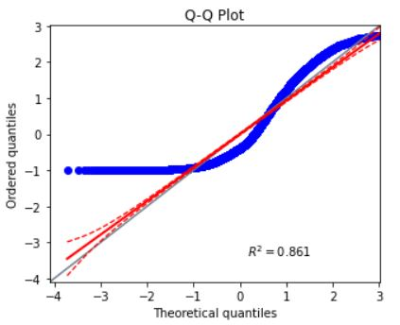
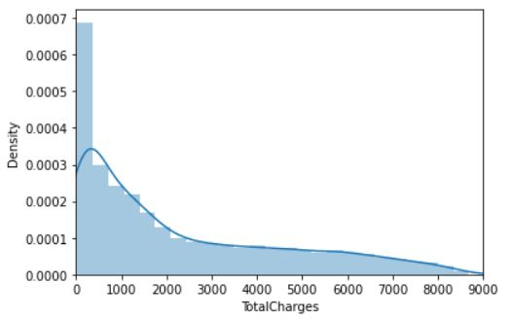
Data Cleaning
Decide missing value imputation strategy

Slide 7
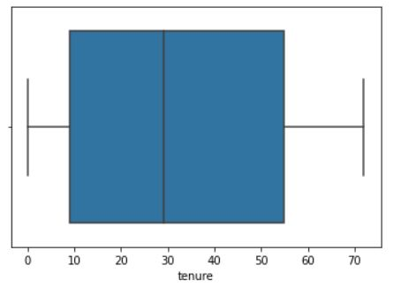
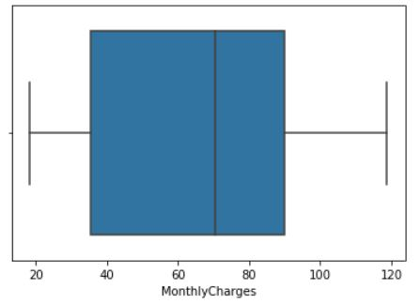
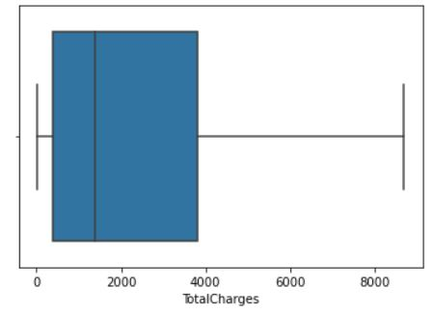
Data Cleaning
Check outlier

Slide 8
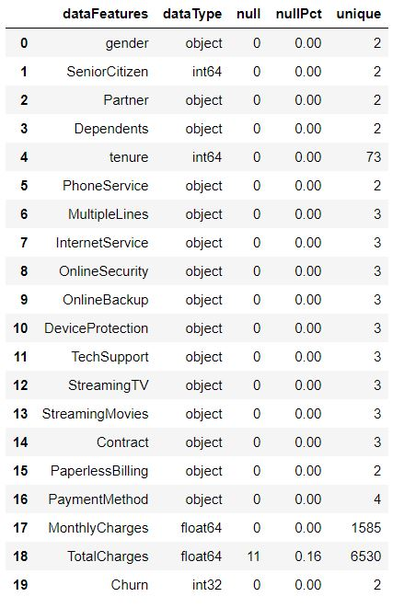
Data Cleaning
Decide strategy for encoding categorical column

Slide 9
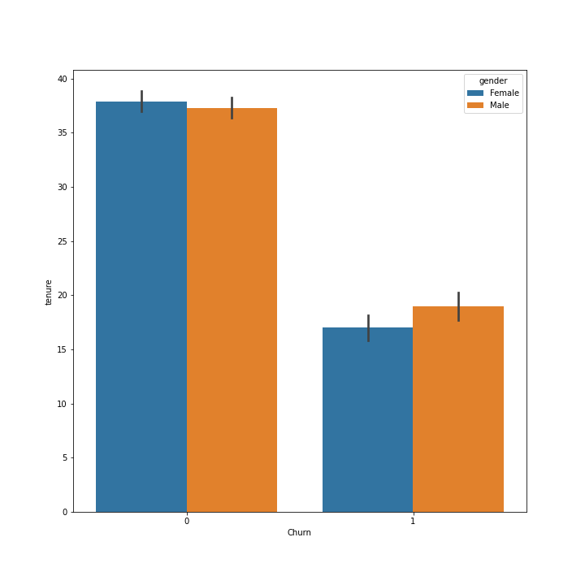
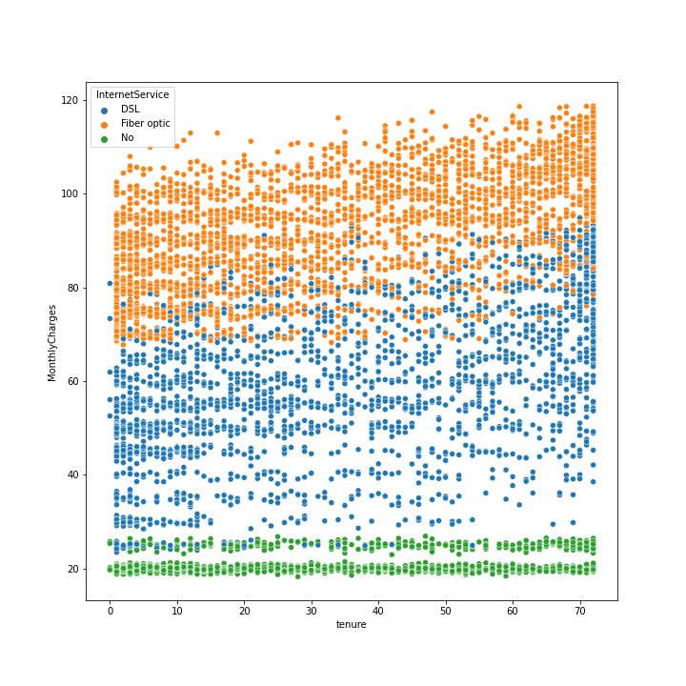
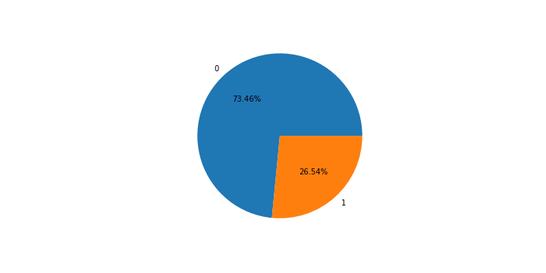
Data Visualization

Slide 10
Modelling
Perform Univariate feature selection
Make model benchmark and model tuning using Decision Tree, K-Nearest Neighbor, Logistic regression, dan Random Forest
Choose best model using recall (+) as scoring

Slide 11
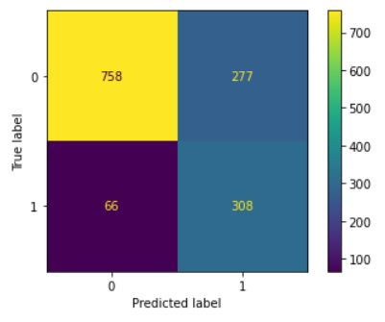
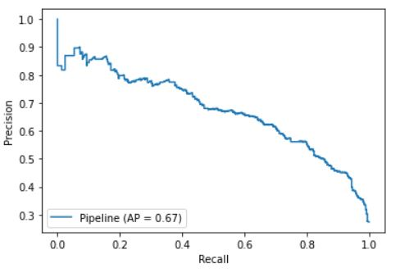
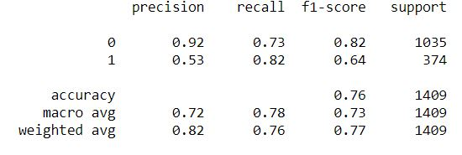
Modelling
Check the performance of chosen model

Slide 12
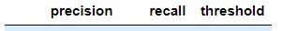
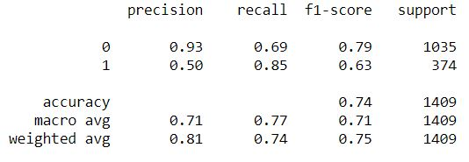
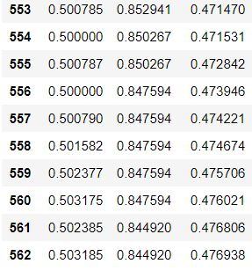
Modelling
Perform threshold optimization on chosen model and save it using pickle

Slide 13
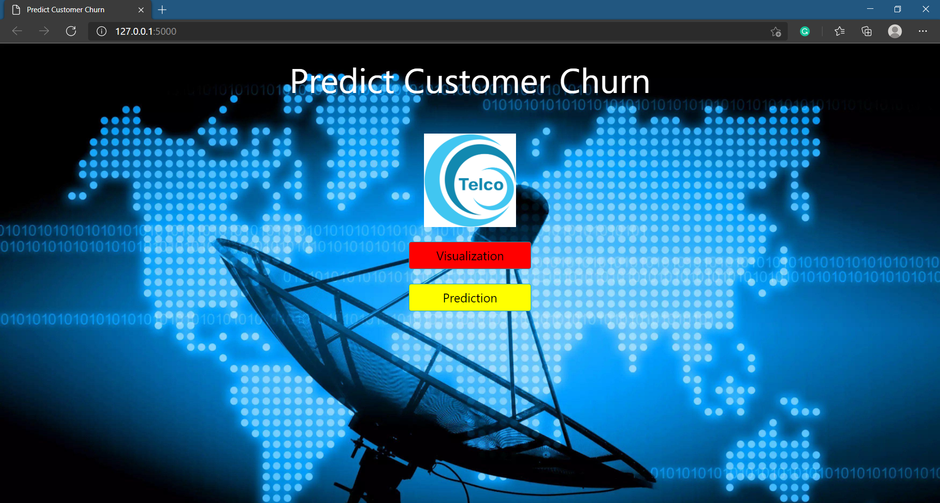
Web App - Home Page

Slide 14
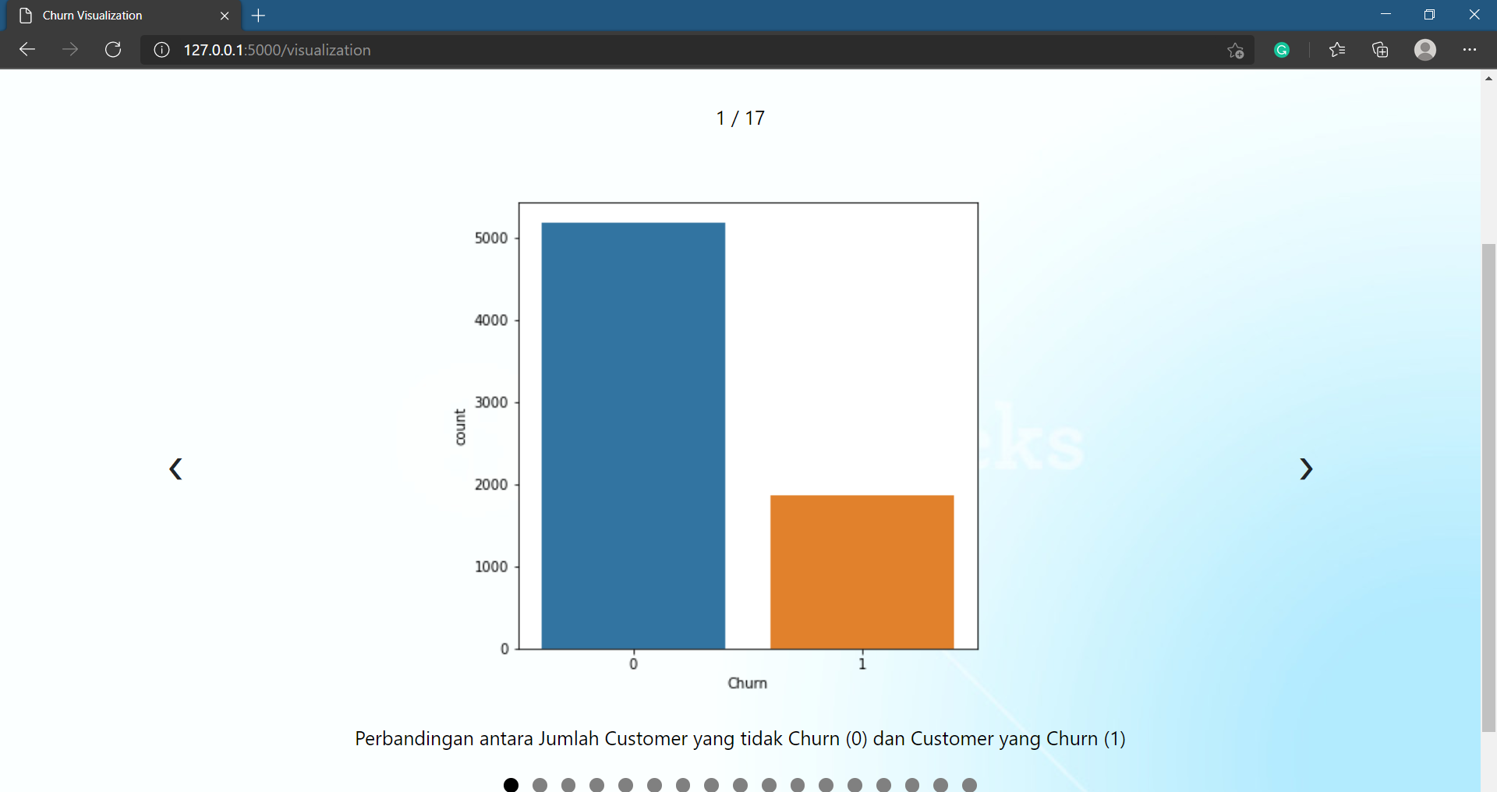
Web App - Visualization Page

Slide 15
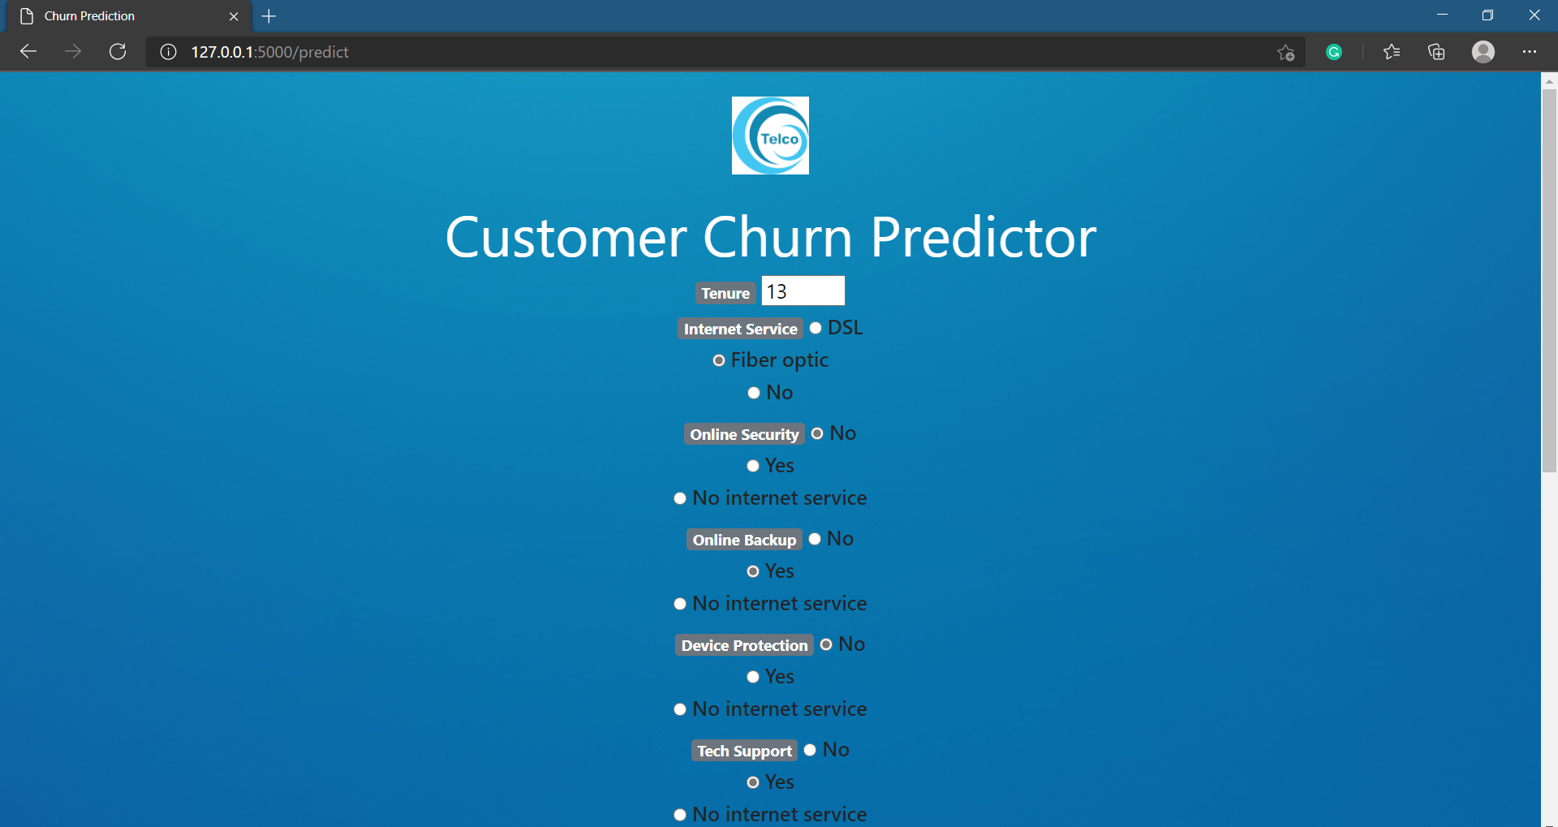
Web App - Predict Page

Slide 16
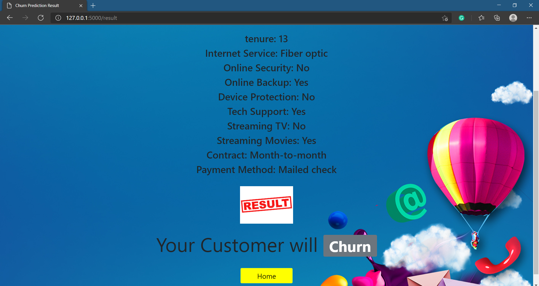
Web App - Result Page

Slide 17



